Slide 1
DANUBE RIVER FLOOD (2002)

Slide 2
GROUP 5
Jayton Birch,
Samantha Day,
Joshua Jolley,
Tania Menendez,
Adele Palmer

Slide 3
1.
Intro & Background
August 2002,
Czech Republic

Slide 4
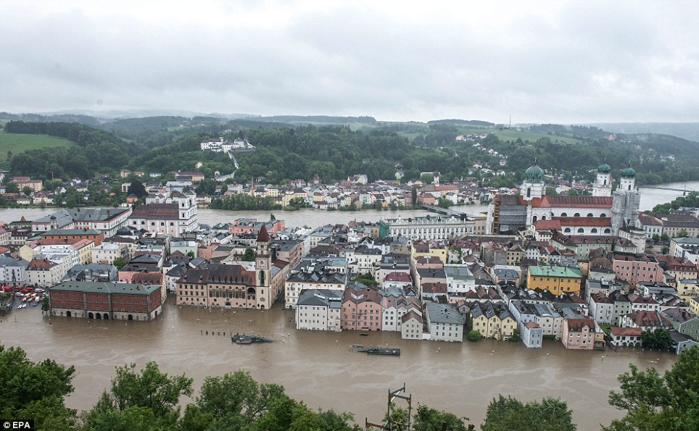
In August 2002 a flood caused by over a week of continuous heavy rains flooded Europe. Czech Republic, Austria, Germany, Slovakia, Poland, Hungary, Romania and Croatia were all effected causing the killing of dozens, dispossessing thousands, and causing damage of billions of euros. The flood was of a magnitude expected to occur roughly once a century.
Tania Menendez "Wild Weather Has Happened Before, Will Again". USA Today. 19 August 2002. Retrieved 17 November 2015.

Slide 5
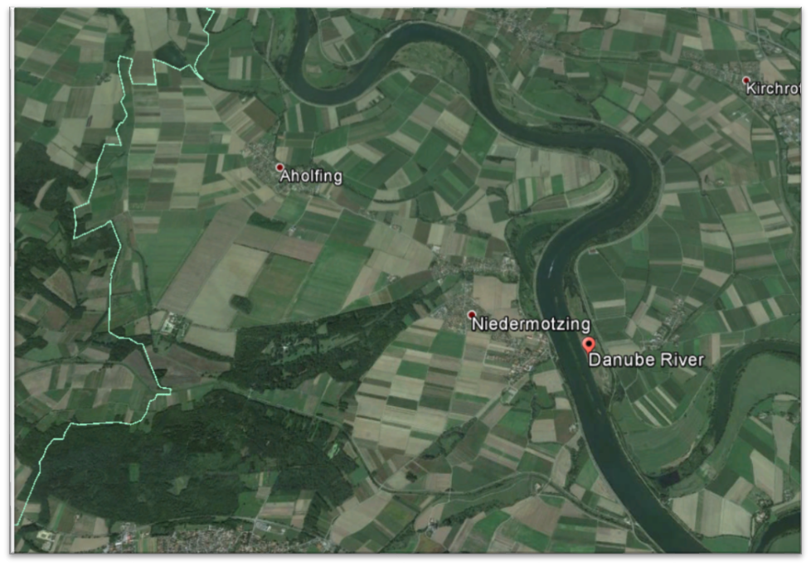
WHERE DID IT HAPPEN?
Tania Menendez Google Earth

Slide 6
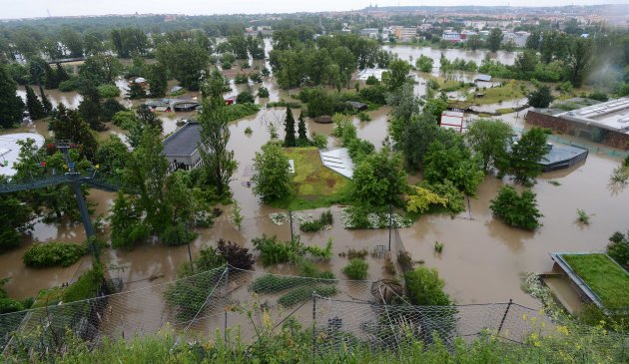
INTRO/BACKGROUND
Rivers changed their courses in unexpected ways, and had massive overflowing of their banks. Water levels in the Czech Republic reached 10- to 20-, or more.
Tania Menendez EQECAT: Central European Flooding August 2002

Slide 7
2.
Science 1
10,000 m³/s discharge!

Slide 8
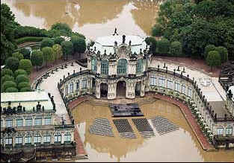
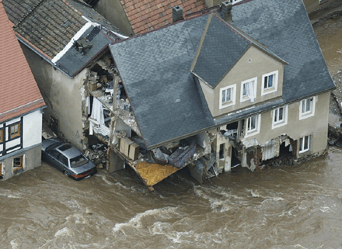
Science 1
Volume
More than 10,000 cubic meter per second recorded in Bratislava
5,300 cubic meters of rainfall in Prague
Cause
The flood was caused by a “Genoa cyclone” -- A low pressure system traveling southeast and then making a sudden turn north east

Slide 9
3.
Science 2
Impacted over eight countries

Slide 10
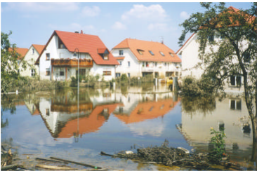
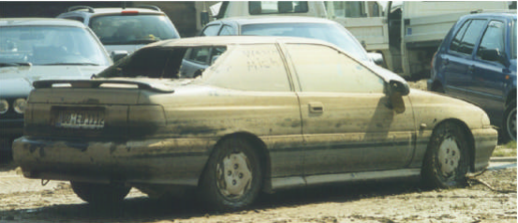
EFFECTS OF FLOOD
Damage
Damage to homes along flood banks.
Heavy damage to utilities.
Destruction
Destruction of commercial and private vehicles
Closures
Bridges and metros were closed.
Jayton Birch

Slide 11
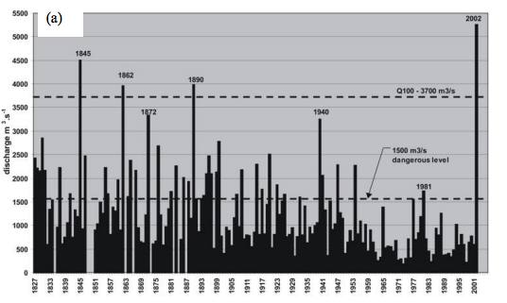
FREQUENCY OF FLOODS
Record
The first time floods of this size have occurred in numerous rivers at the same time.
El Niño
It is speculated that these floods are likely to continue as they are linked to global warming which causes an “El Niño” climate causing heavy rainfall.
Jayton Birch

Slide 12
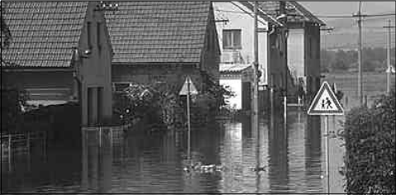
FACTORS THAT AFFECT THE DISASTER
Attribution
The floods have been attributed to sealing, river regulation, and the disappearance of natural flood retention areas.
Development “Boom”
A “boom” in development along river banks has cause more risk for property damage.
Jayton Birch

Slide 13

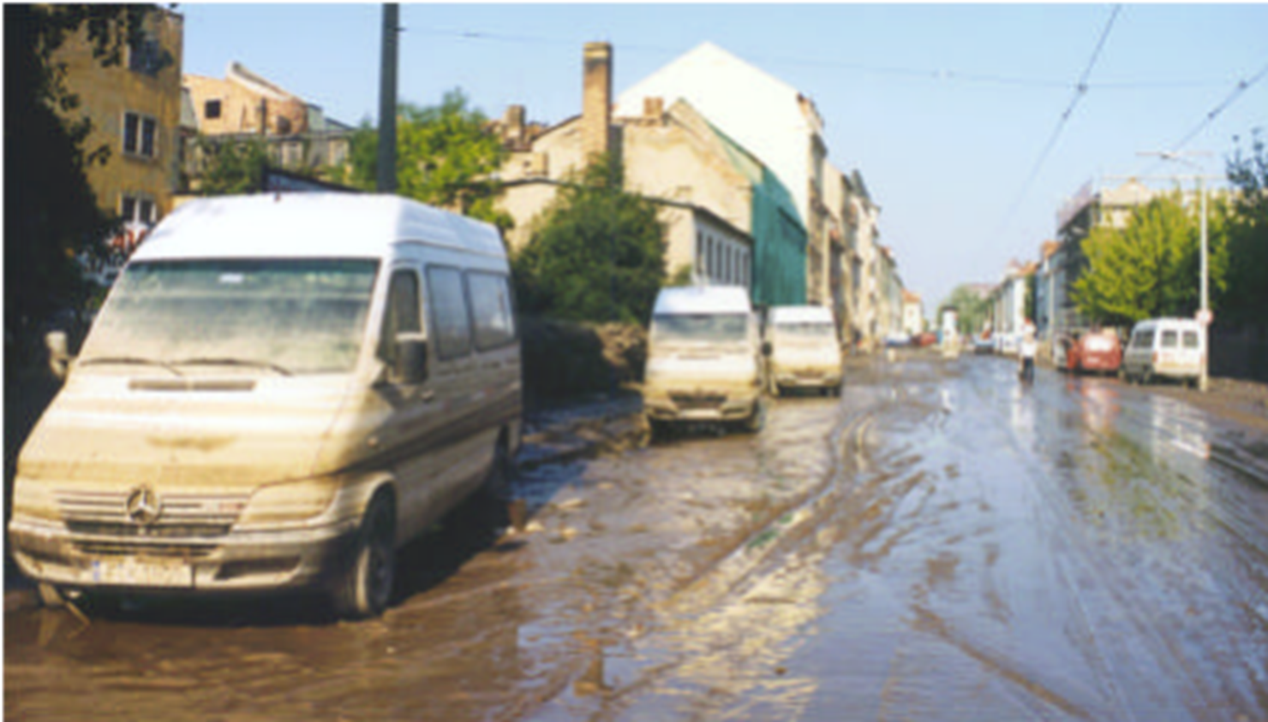
Interesting Facts
The floods affected over eight countries.
The river last flooded to this extent in 1845.
The after math of the flood led to tens of inches of mud being caked on roads rendering them useless.
Jayton Birch

Slide 14
4.
Eye Witness
In some places, it wasn’t so bad

Slide 15
Eye Witness
Contrary to many of the reports, there are some bridges open in Prague, there are few to none panicking, electricity is not out everywhere in the center, kids on a trip are hard to reach because they are not sitting next to a phone, (they are most likely out and about), the Czech Govt seem to be handling this pretty well, Havel did fly back home. Floods just happen from time to time. Be happy for the relatively low loss of life. "Things" dry out. [1] -- Chris, Czech Republic

Slide 16
5.
Conclusion
A hundred
year flood

Slide 17
Conclusion
This was a hundred year flood.
This flood dispossessed thousands and killed 110 people.
Bratislava flood discharged over 10,000 m³/s, which is almost 4 times the discharge of the Niagara Falls. Prague experienced a discharge of 5,300 m³/s.
This river wasn’t the only river flooding on the continent at the time and multiple countries were effected.

Slide 18
References
[1] CNN, Fighting the floods: Your Say, Aug 21, 2002. Online Available: http://edition.cnn.com/2002/WORLD/europe/yoursay/08/13/floods.yoursay/
"Wild Weather Has Happened Before, Will Again". USA Today. 19 August 2002. Retrieved 17 November 2015. EQECAT: Central European Flooding August 2002 http://www.sciencemag.org.byui.idm.oclc.org/content/300/5622/1099.full
http://www.newprophecy.net/2002page.htm
Google earth

